Slide 1
Citi Bike NYC Trip Segmentation and Station Network Analysis Team Citi Slickers
Jessica Rudd
Shashank Hebbar
Soujanya Mandalapu

Slide 2
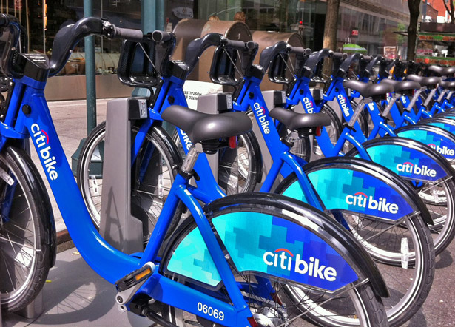

Citi Bike is the nation's largest bike share program, with 10,000 bikes and 600 stations across Manhattan, Brooklyn, Queens and Jersey City. It was designed for quick trips with convenience in mind, and it’s a fun and affordable way to get around town.

Slide 3
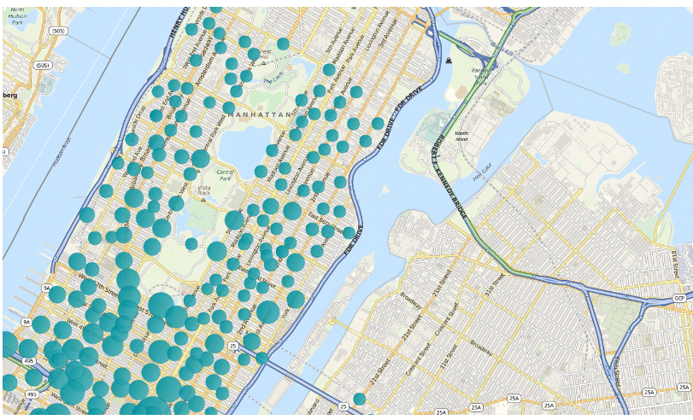
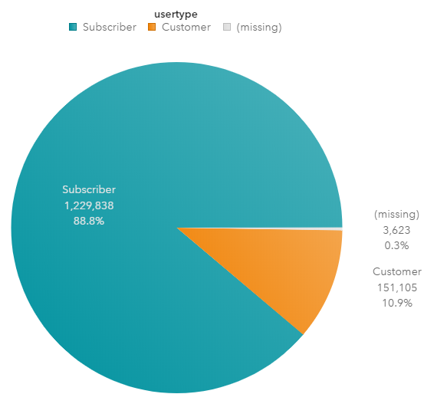
Above visualization is a map that shows in which places these bike share companies located and bubbles that you
see are the stations where these bikes available.
Of all of our total users, 89% of the users are Subscribers and rest 11% were Customers.
Subscribers are typically the working population that resides in these areas where as customers are
likely to be tourists.

Slide 4
So
Where do city Bikers ride?
When do they ride?
How far do they go?
Which Stations are most popular?
What days of the week are most riders take on?

Slide 5
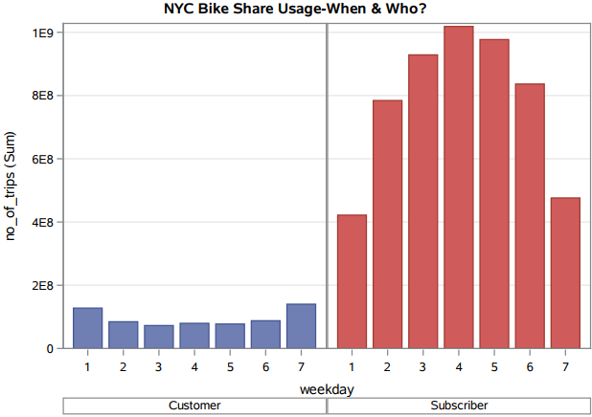
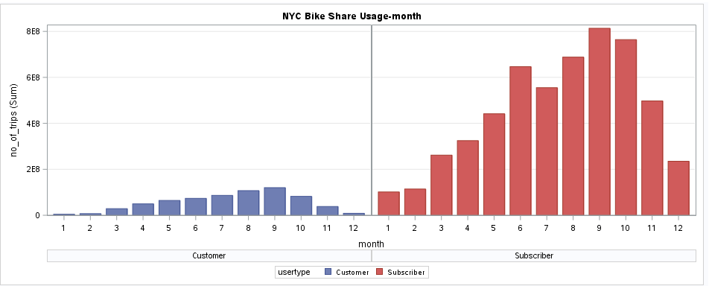
Customers seem riding more on weekends when compared to weekdays
Subscribers seem riding more on weekdays when compared to weekends
Customers seem riding more on summer and fall than winter
Subscribers have similar pattern as of customers but notice there was a dip in rides in the month of July

Slide 6
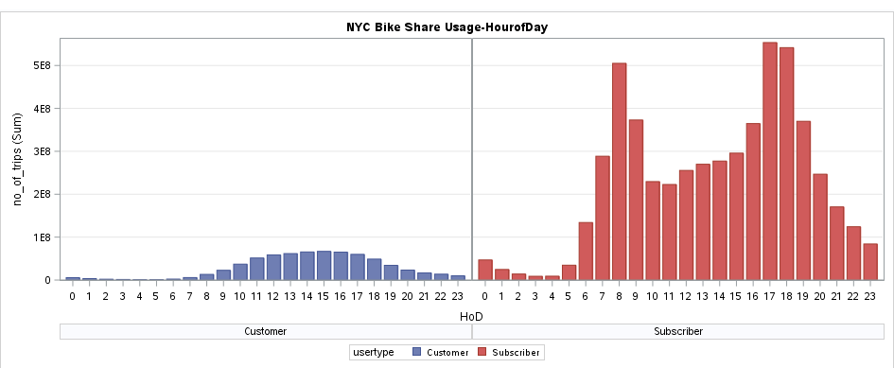
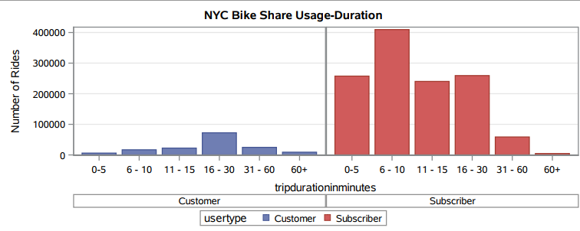
Subscribers take more rides during morning and evening rush hours but customers take more rides as the day progresses which peaks in the afternoon
More number of customers rent bike for longer duration (16-30 mins) where as subscribers rent bike typically for shorter duration (6-10 mins)

Slide 7
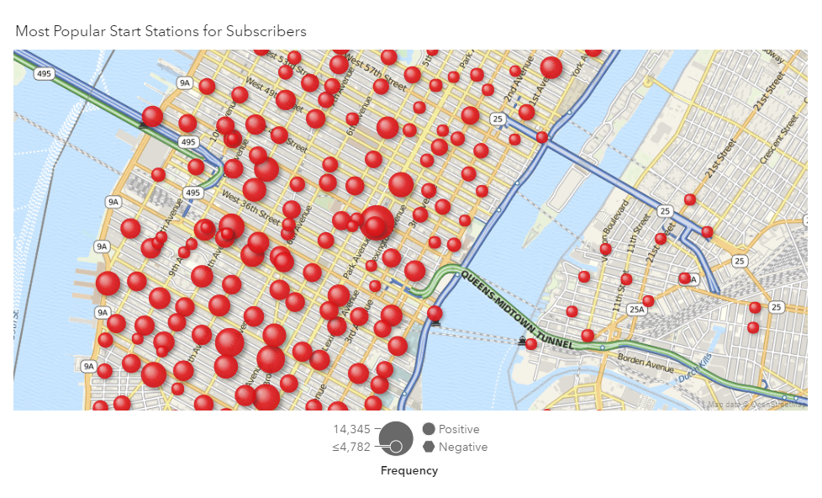
Geospatial representation of popular stations using SAS Visual Analytics
Most Popular Start Stations for Subscribers
Note that most popular stations for Subscribers are around Grand Central Terminal

Slide 8
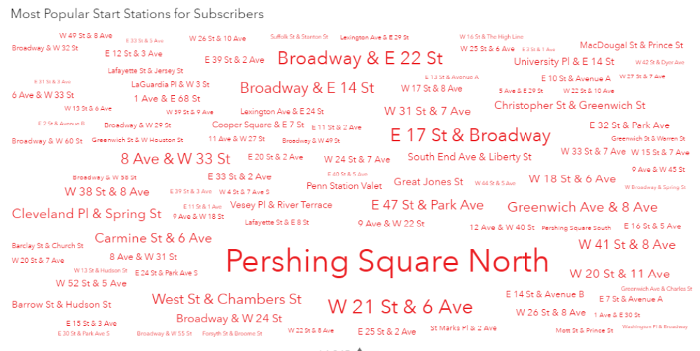
Most Popular Start Stations for Subscribers
Bigger the size of text more the number of trips starting or ending at these stations
Most famous start stations for subscribers are Pershing square in Manhattan in front of Grand Central Terminal, Broadway& E 22 St ,W21st & 6 Ave etc.

Slide 9
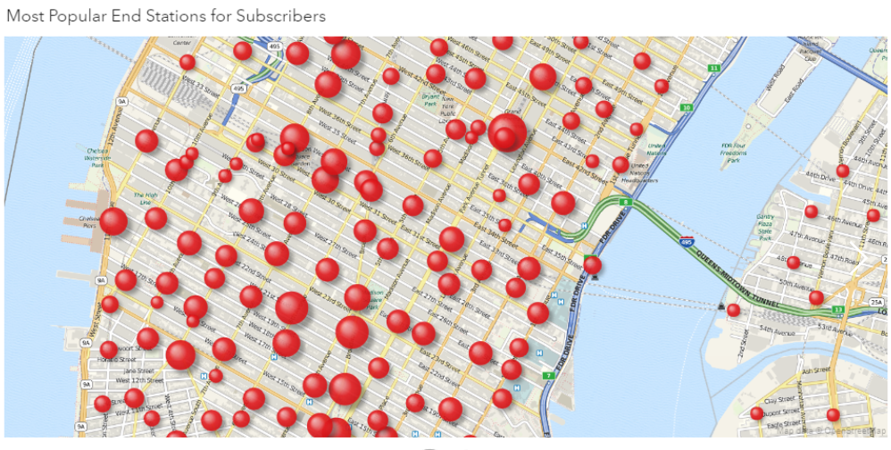
Geospatial representation of popular stations using SAS Visual Analytics
Most Popular End Stations for Subscribers

Slide 10
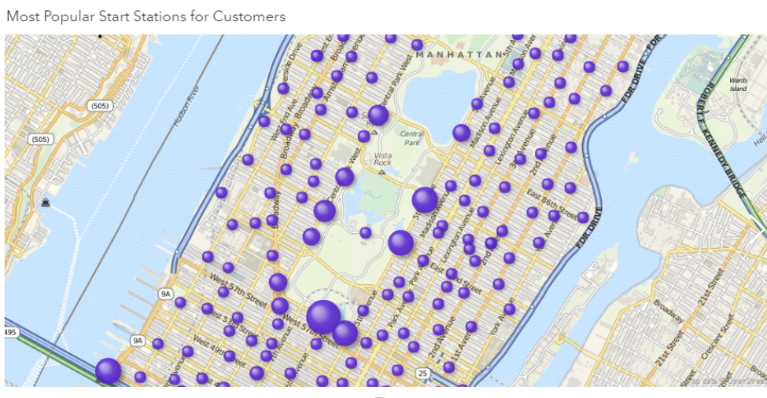
Geospatial representation of popular stations using SAS Visual Analytics
Most Popular Start Stations for Customers
Note that most popular stations for customers are around Central Park

Slide 11
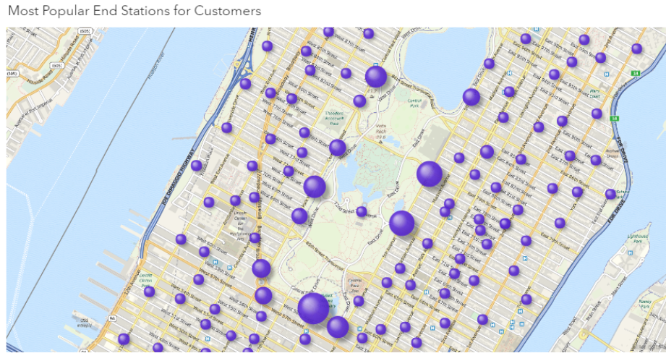
Geospatial representation of popular stations using SAS Visual Analytics
Most Popular End Stations for Customers
Central Park, NY

Slide 12
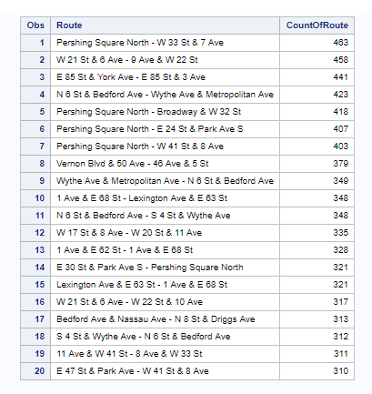
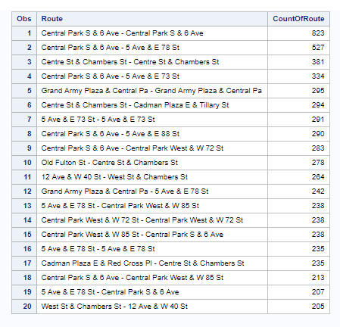
Popular Routes for Customers and Subscribers
Top 20 busiest Routes for Subscribers
Top 20 busiest Routes for Customers

Slide 13
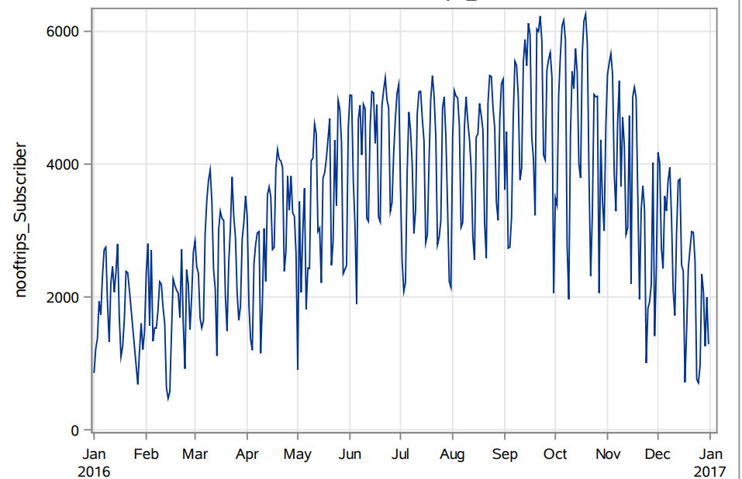
Time Series of Rides over the last year (Jan.2016 - Dec.2016) for Subscribers
Independence day
Thanksgiving
Reason for Rise and Fall in the rides is due to usage of bikes on weekdays and weekends.
Subscribers tend to ride bikes low on the weekends and holidays but rent bikes more during weekdays to commute to their workplace.

Slide 14
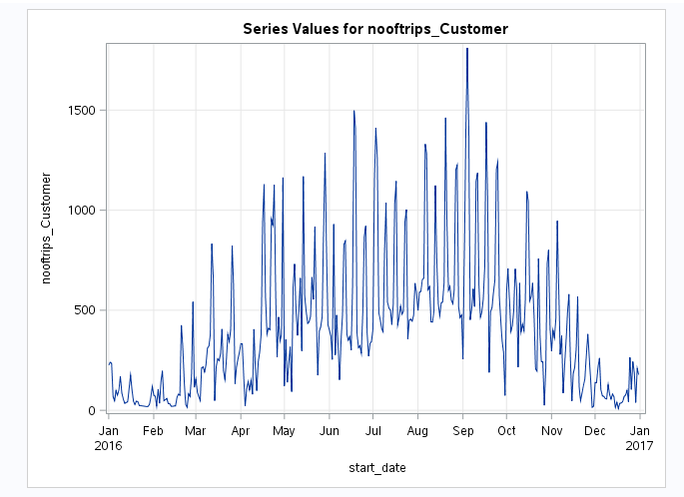
Time Series of Rides over the last year (Jan.2016 - Dec.2016) for Customers
Independence day
Labor Day
Thanksgiving
Reason for Rise and Fall in the rides is due to the usage of bikes on weekends and weekdays.
Rise in the rides for Customers mainly observed on the weekends and Holidays compared to weekdays.

Slide 15
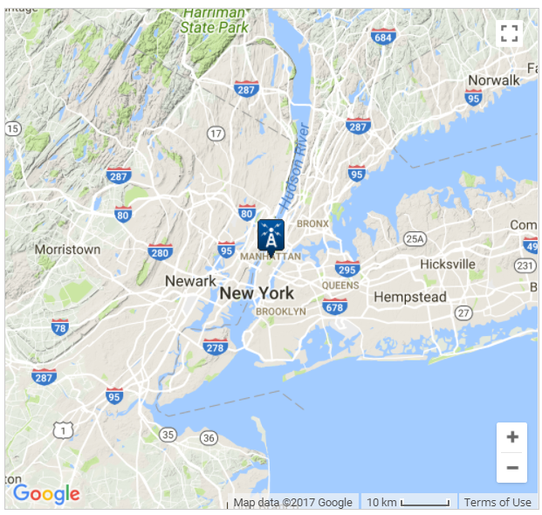
Weather Data from National Climatic Data Center
To provide additional insight for segmenting trips and riding days, a publicly available dataset of weather in the NYC area was merged by day with the trip data. This dataset included maximum and minimum temperatures, precipitation, snow, and wind for each day .
It was taken from the national climatic data center. The data set included variables like temperature, snow, precipitation, and wind speed. These observations were merged on the latitude and longitude column to the Citi bike dataset.
https://www.ncdc.noaa.gov/climate-information/extreme-events

Slide 16
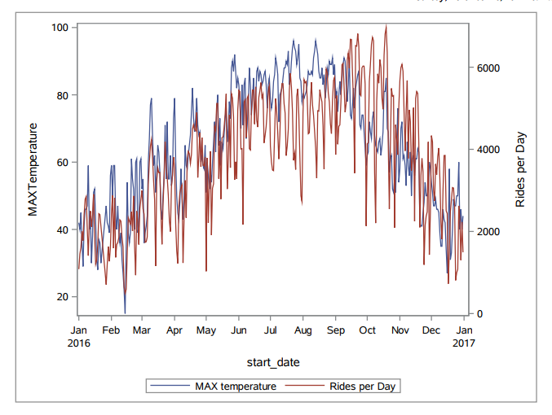
Time series of Rides in a Day and Maximum Temperature
Number of rides decrease in a day with dip in temperature

Slide 17
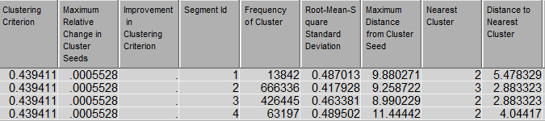
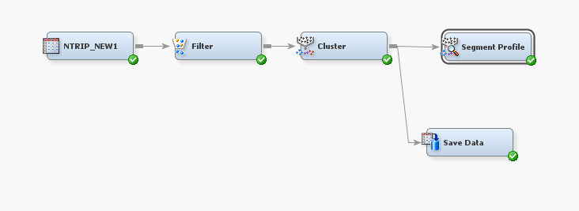
Clustering to divide the dataset into certain distinctive characteristics
Variable | Variable Description
AWND | Average Wind Speed
HoD | Hour of Day
PRCP | Precipitation
SNOW | Snow (Indicator)
Tmax | Maximum Temperature
Tmin | Minimum Temperature
age | Age of rider
gender | Gender of Rider
month | Month of year
no_of_trips | No of trips per day
rush | nominal variable for rush hour of the day
trip_duration | Trip duration of each ride
weekday | Week day of the week
workday | Binary indicator for weekday/weekend
Cluster statistics
Variables used in clustering
E.M Diagram Flow

Slide 18
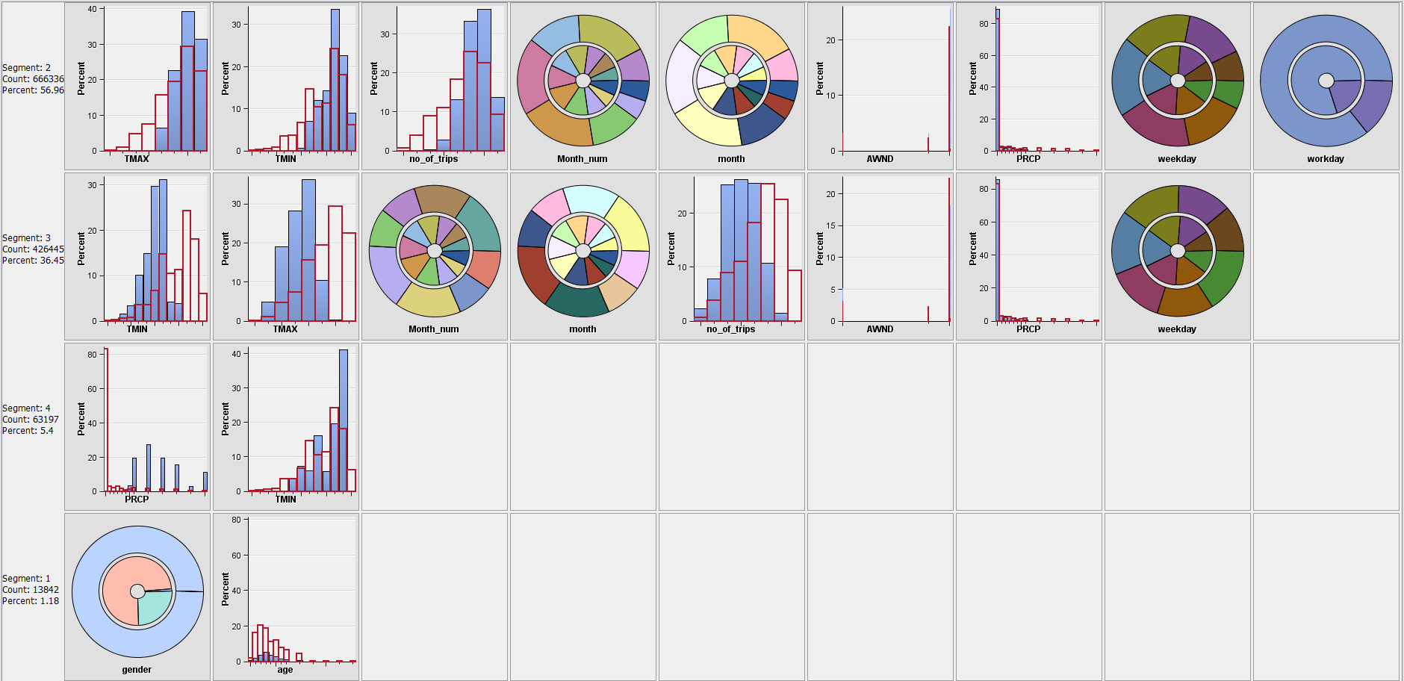
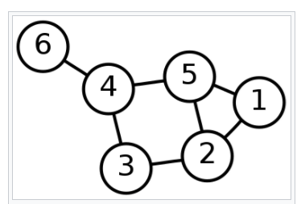
Segmentation Characteristics
Segment Profile

Slide 19
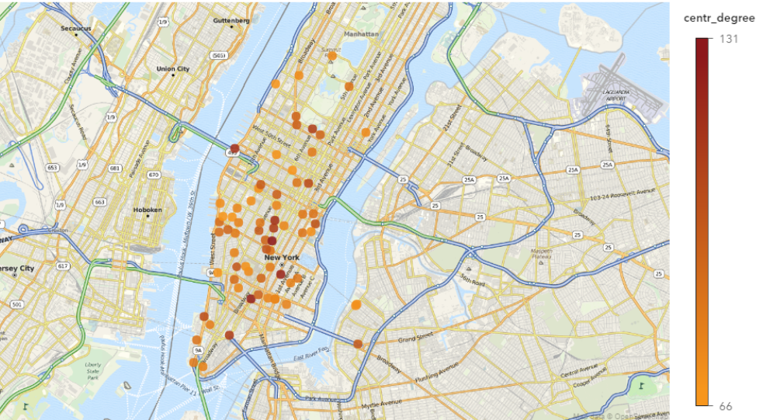
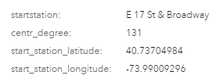
Map of Busiest Stations by Degree Centrality, Citi Bike Trip Cluster 1

Slide 20
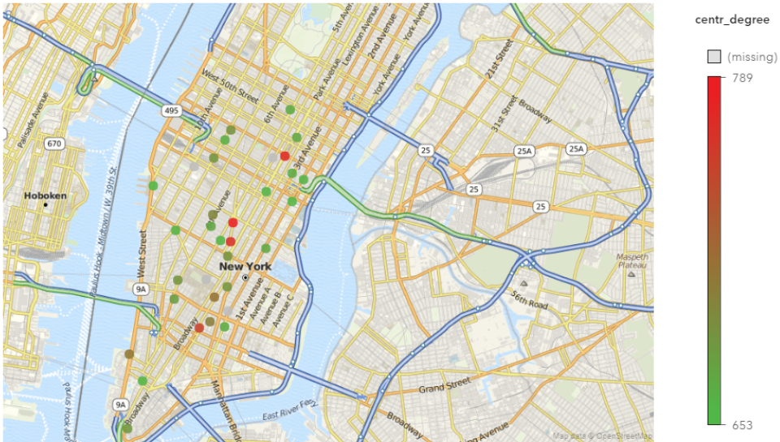
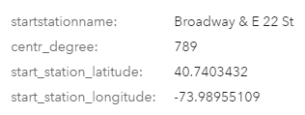
Map of Busiest Stations by Degree Centrality, Citi Bike Trip Cluster 2

Slide 21
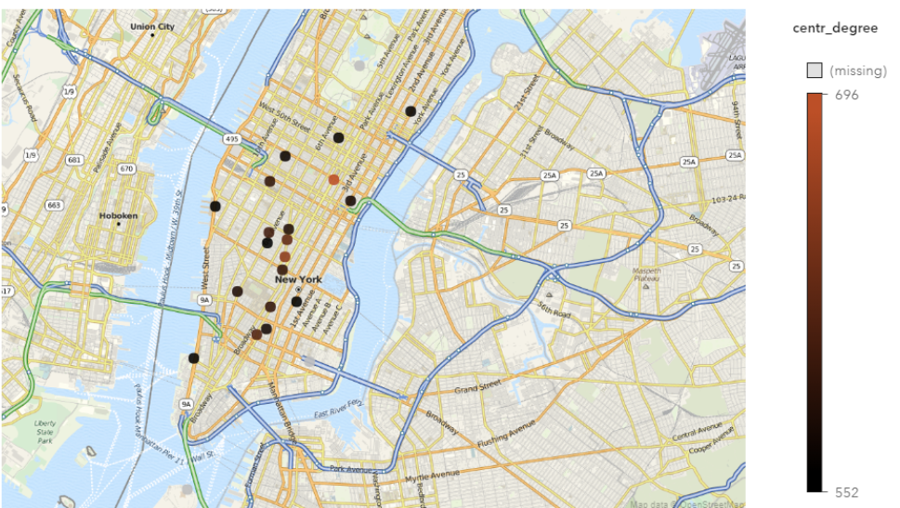
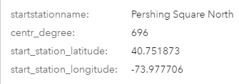
Map of Busiest Stations by Degree Centrality, Citi Bike Trip Cluster 3

Slide 22
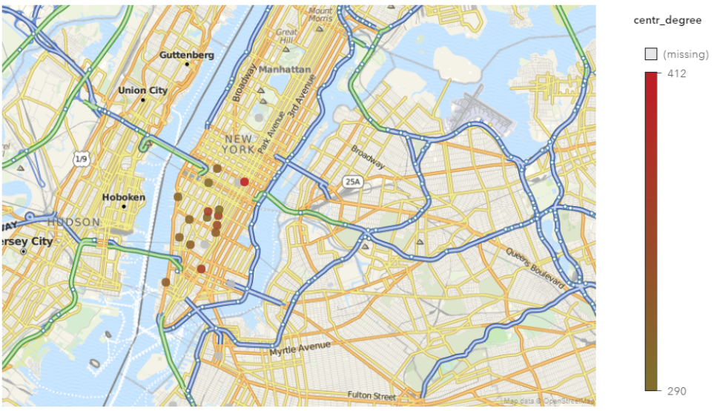
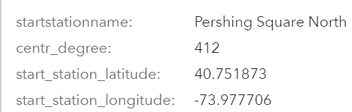
Map of Busiest Stations by Degree Centrality, Citi Bike Trip Cluster 4

